Slide 1

Recursion
I am what I am

Slide 2
Solving Problems in the most general of ways
Recognize a solution when you see it.
Search the elements of a set for a solution.

Slide 3
Our Interests
We are interested in solving a problem by decomposing it into one or more smaller problems and then combining the results.
In general, problems can be decomposed in one of two ways:
arithmetically (e.g., n-1), or
geometrically (e.g., n/2).
The notion of a predecessor of a value is central to our problem decomposition approach.

Slide 4
Recursion
We are interested in values belonging to well-founded countable sets. Examples include the following.
positive integers and non-negative integers
terms (aka trees)
lists
Such a framework/perspective is well-suited for recursive programming.
In this framework, induction can be used to reason about properties of recursively defined computations.

Slide 5

Foundations of Induction
Inductive arguments come in several flavors.

Slide 6
Partial Order
A relation R on a set S is called a partial ordering or partial order if it is reflexive, antisymmetric, and transitive.
Example: the relational operator ≤
A set S together with a partial ordering R is called a partially ordered set, or poset, and is denoted by (S,R).
In general we will write (S,≤) to denote an arbitrary relation.

Slide 7
Total Order
If (S,≤) is a poset and every two elements of S are comparable, S is called a totally ordered set or linearly ordered set, and ≤ is called a total order or a linear order.
A totally ordered set is also called a chain.
Example: Let S be the set of integers and let ≤ be the relational operator less-than-or-equal-to.

Slide 8
Well-founded orders
A totally ordered set (S,≤) is said to be well ordered (or have a well-founded order) iff every nonempty subset of S has a least element.
Every finite totally ordered set is well ordered.
The set of integers Z, which has no least element, is an example of a set that is not well ordered.
An ordinal number is the order type of a well ordered set.
http://mathworld.wolfram.com/WellOrderedSet.html

Slide 9
Mathematical Induction
Definition 1. Proving that P(n) is true for all positive integers n, where P(n) is a propositional function, can be accomplished via the following two steps.
Basis Step: We verify that P(1) is true.
Inductive Step: We show that the conditional statement P(k) → P(k + 1) is true for all positive integers k.
Remark. In a proof by mathematical induction it is not assumed that P(k) is true for all positive integers! It is only shown that if one assumes that P(k) is true then it can be shown that P(k + 1) must also be true.

Slide 10
Strong Induction
Definition 1. Proving that P(n) is true for all positive integers n, where P(n) is a propositional function, can be accomplished via the following two steps.
Basis Step: We verify that P(1), P(2), …, P(i) are true.
Inductive Step: We show that the conditional statement (P(1) ∧ … ∧ P(k)) → P(k + 1) is true for all positive integers k ≥ i.

Slide 11
Strict partial orders
A strict partial ordering (S,>) is called well-founded (Noetherian), if there is no infinite decreasing chain
a₀ > a₁ > a₂ > …
with a_{i} ∈ S.
Example. (P(S), ⊂)

Slide 12
The Strict Subset relation (⊂) over the elements of a Power set
{1,2,3}
{1,2}
{1,3}
{2,3}
{1}
{2}
{3}
{}
subsets of P({1,2,3})

Slide 13
The principle of well-ordered (Noetherian) induction
Suppose that (S,<) is a well-ordered set. Then P(x) is true for all x ∈ S, if
Inductive Step:
For every y ∈ S, if P(x) is true for all x ∈ S with x < y, then P(y) is true.

Slide 14
Structural Induction
Structural induction can be used to prove P about recursively defined sets (e.g., trees) as follows.
Basis: Show that P holds for all elements specified in the base step of the recursive definition of the set.
Inductive Step: Show that if P is true for each of the elements used to construct the new elements in the recursive step of the definition, then P holds for these new elements.

Slide 15
SML Code
Computing a sum

Slide 16
Problem Statement
Write an SML function, called sum, that when given a
non-negative integer n, computes the following.
sum n = 0 + 1 + ... + n

Slide 17
Sequence and Recurrence Relation
a₀
a₁
a₂
a₃
a₄
a₀ = 0
a₀ = 0
a_{n+1} = a_{n} + (n+1)
a_{n} = a_{n-1} + n

Slide 18
Version 1 - Down
fun sum 0 = 0
| sum n = n + sum(n-1);
sum 3
→ 3 + (sum(3-1))
→ 3 + (sum(2))
→ 3 + (sum 2)
→ 3 + (2 + sum(2-1))
→* 3 + (2 + (1 + (sum 0))
→* 3 + (2 + (1 + 0))
→* 6

Slide 19
Version 2 - Up
fun sum (i,n) = if i = n then n
else i + sum(i+1,n);
sum (0,10);
measure: n − i > n − (i + 1)

Slide 20
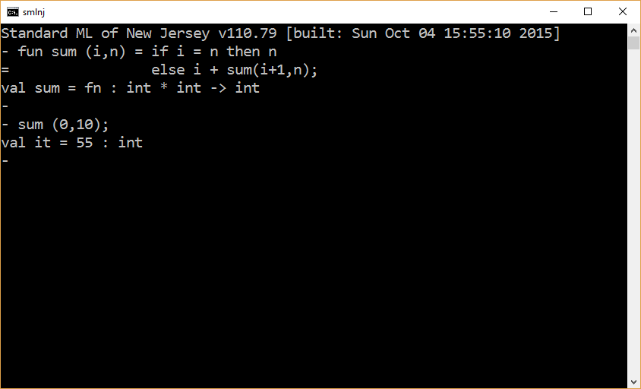

Slide 21
Validation through closed forms
sum(0,10) = 55
Is this correct?
10 * (10 + 1) / 2 = 55
How do we know this closed form computation is correct? (Through an inductive proof).

Slide 22
The end

